Slide 1
BUSINESS MANAGEMENT
SELECTION PROCESS

Slide 2
DEFINITION
The Selection is a process of picking the right candidate with prerequisite qualifications and capabilities to fill the jobs in the organization.
The selection process is quite lengthy and complex as it involves a series of steps before making the final selection.
The procedure of selection may vary from industry to industry, company to company and even from department to department.
Every organization designs its selection process, keeping in mind the urgency of hiring people and the prerequisites for the job vacancy.

Slide 3
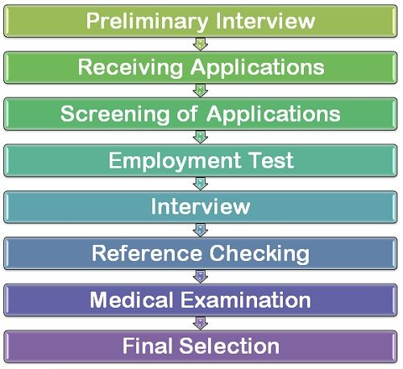
SELECTION PROCESS

Slide 4
SELECTION PROCESS
Preliminary Interview:
The preliminary interview is also called as a screening interview wherein those candidates are eliminated from the further selection process who do not meet the minimum eligibility criteria as required by the organization.
Here, the individuals are checked for their academic qualifications, skill sets, family backgrounds and their interest in working with the firm.
The preliminary interview is less formal and is basically done to weed out the unsuitable candidates very much before proceeding with a full-fledged selection process.
Receiving Applications:
Once the individual qualifies the preliminary interview he is required to fill in the application form in the prescribed format.
This application contains the candidate data such as age, qualification, experience, etc. This information helps the interviewer to get the fair idea about the candidate and formulate questions to get more information about him.

Slide 5
SELECTION PROCESS
Screening Applications:
Once the applications are received, these are screened by the screening committee, who then prepare a list of those applicants whom they find suitable for the interviews.
The short listing criteria could be the age, sex, qualification, experience of an individual.
Once the list is prepared, the qualified candidates are called for the interview either through a registered mail or e-mails.
Employment Tests:
In order to check the mental ability and skill set of an individual, several tests are conducted.
Such as intelligence tests, aptitude tests, interest tests, psychological tests, personality tests, etc.
These tests are conducted to judge the suitability of the candidate for the job.

Slide 6
SELECTION PROCESS
Employment Interview:
The one on one session with the candidate is conducted to gain more insights about him.
Here, the interviewer asks questions from the applicant to discover more about him and to give him the accurate picture of the kind of a job he is required to perform.
Also, the briefing of certain organizational policies is done, which is crucial in the performance of the job.
Through an interview, it is easier for the employer to understand the candidate’s expectations from the job and also his communication skills along with the confidence level can be checked at this stage.
Checking References:
The firms usually ask for the references from the candidate to cross check the authenticity of the information provided by him.
These references could be from the education institute from where the candidate has completed his studies or from his previous employment where he was formerly engaged.
These references are checked to know the conduct and behaviour of an individual and also his potential of learning new jobs.

Slide 7
SELECTION PROCESS
Medical Examination:
Here the physical and mental fitness of the candidate are checked to ensure that he is capable of performing the job.
In some organizations, the medical examination is done at the very beginning of the selection process while in some cases it is done after the final selection.
Thus, this stage is not rigid and can take place anywhere in the process.
The medical examination is an important step in the selection process as it helps in ascertaining the applicant’s physical ability to fulfill the job requirements.
Final Selection:
Finally, the candidate who qualifies all the rounds of a selection process is given the appointment letter to join the firm.
Thus, the selection is complex and a lengthy process as it involves several stages than an individual has to qualify before getting finally selected for the job.

